Slide 1
Advanced Control of Robotic Surface Treatments
RPI: John Wen, Glenn Saunders, William Lawler, Shuyang Chen, Alex Elias
UTRC: Abhijit Chakraborty, Mike Klecka
08/2/2019

Slide 2
Agenda
Project update: RPI subcontract under review
Testbed update
FEM
RobotStudio simulation
GitHub Repository
Architecture

Slide 3
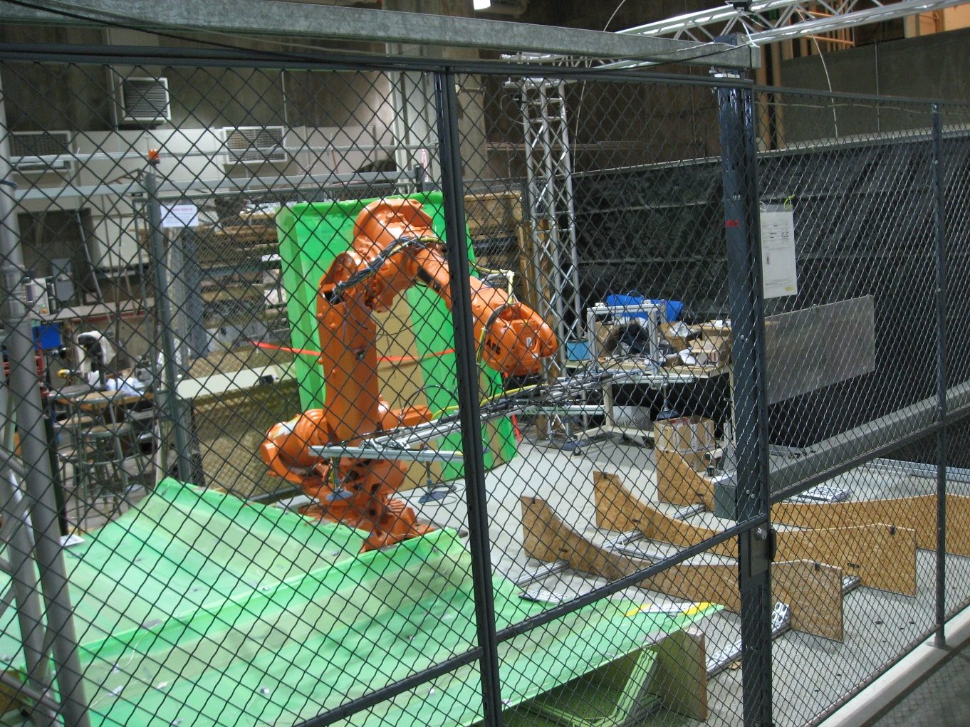
Testbed: Proposed Location
Need to get rid of this table
Load-bearing work table for burnishing here, to left of robot.

Slide 4
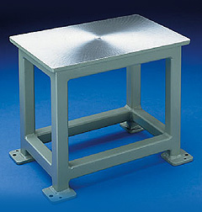
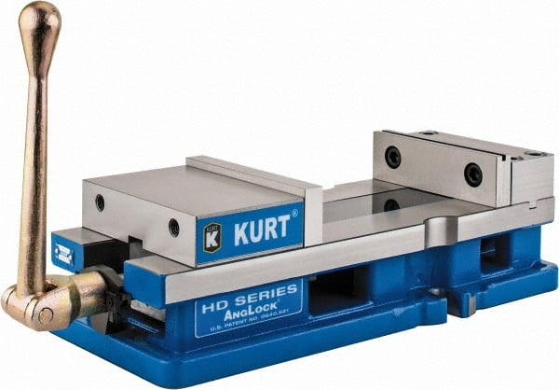
Testbed: Initial Concept of Work Table
Brute machine base
Kurt vise
Bolt vise to machine base.
Bolt machine base to floor.
Place coupons inside vise.
Very rugged, easy to set up and exchange coupons
Not very flexible for other experiments.

Slide 5
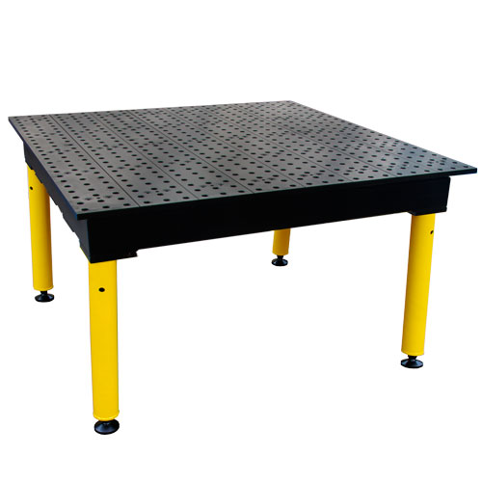
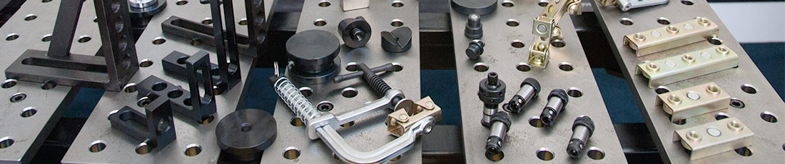
Testbed: Proposed Work Surface
BuildPro modular welding tabletop
5/8 thick plates.
Hardened surface (HV 550)
5/8 diameter holes.
1,500 lbs per leg capacity
3 Reasons for welding tabletop
1. Easier/faster changeover for experiments (GE composites for example).
2. Future fixturing.
3. Compatibility with welding laboratory.
Problems:
Not bolted to floor, ability to take side loads.

Slide 6
Testbed: Current Status
Near-term testbed punch list:
Finish bolting down ABB robot.
Select work table & fixturing (vise), place orders.
Clean out smaller work table currently in testbed space.
Rework vacuum gripper for registration pins (for ease of remove/replace).
Select burnishing tool, design end effector.

Slide 7
FEM
RPI campus licenses:
Altair HyperWorks
Bentley STAAD.Pro
Siemens NX
Abaqus student license (for smaller mesh)?

Slide 8

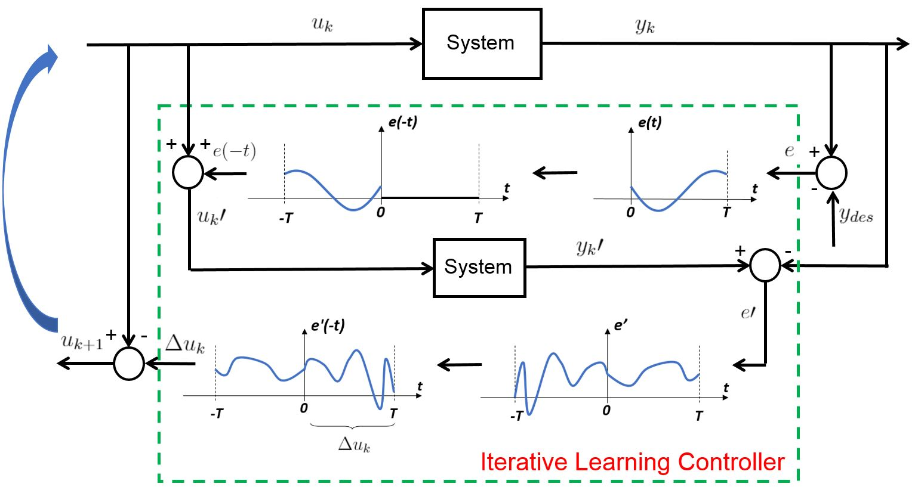
Simulation
Update the software instruction for motion/force control in RobotStudio. Will add robot compliance model, and roller and workpiece model when available.
Forward dynamics: Use neural network to approximate the nonlinear mapping from motor torque to joint acceleration based on data from RobotStudio
Extension of ILC motion control to ILC motion/force control:

Slide 9
Cognibotics
Adam Nilsson (Rep in Brooklyn):
Technology:
Joint identification (including compliance and backlash): Done by clamping the tool/flange to a rigid point in the cell and load the motors in a predetermined sequence. Typically do this by bolting one end of a robot tool-changer to the floor and the solution for the load sequence is fairly mature for ABB robots.
Mass and inertia identification: Based on measurements on the robot during free space motion.
Kinematic calibration: He doesn’t have the equipment for it in NY at the moment. (I don’t think we really need this for now)

Slide 10
Architecture
EGM: 4ms loop
Joint angle command: update through EGM
Force Feedback: 2KHz force measurements for compliance control
Motion Feedback: Joint angle feedback based on motion error
Could do in ROS or RR, RR has the advantage of allowing MATLAB interface
Testing in RobotStudio first

Slide 11
Project Repository
https://github.com/rpiRobotics/ARM-18-01-UTRC-Robotic-Burnishing-Polishing/tree/master/Literature
Literature
Meeting
Simulation
Testbed (BOM)?
Software?

Slide 12
Next Meeting
Testbed
FEM
Motion/force ILC testing in RobotStudio simulation

